Slide 1
Session 2
AMBITIONS
BRINGING CONNECTIVITY
TO THE MOON AND BEYOND

Slide 2
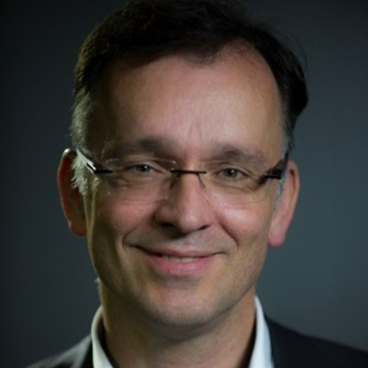
Bernhard Hufenbach leads the commercialisation and innovation team of the ESA Directorate for Human and Robotic Exploration. In this function, he is responsible for developing and implementing a comprehensive innovation plan for space exploration, which includes the delivery of new initiatives aimed at paving the way for a future low Earth orbit and lunar economy.
He has worked at ESA for 31 years in areas such as strategic planning, innovation management, project management, policy development, programme appraisal and evaluation, strategic partnership development, future studies and programme definition, outreach and technology development with a particular focus on space exploration.
Hufenbach holds two Master's degrees from the Technical University of Berlin and Delft in space systems and technologies and space system engineering, respectively.
Bernhard Hufenbach
Commercialisation & Innovation Team Leader
European Space Agency (ESA)

Slide 3
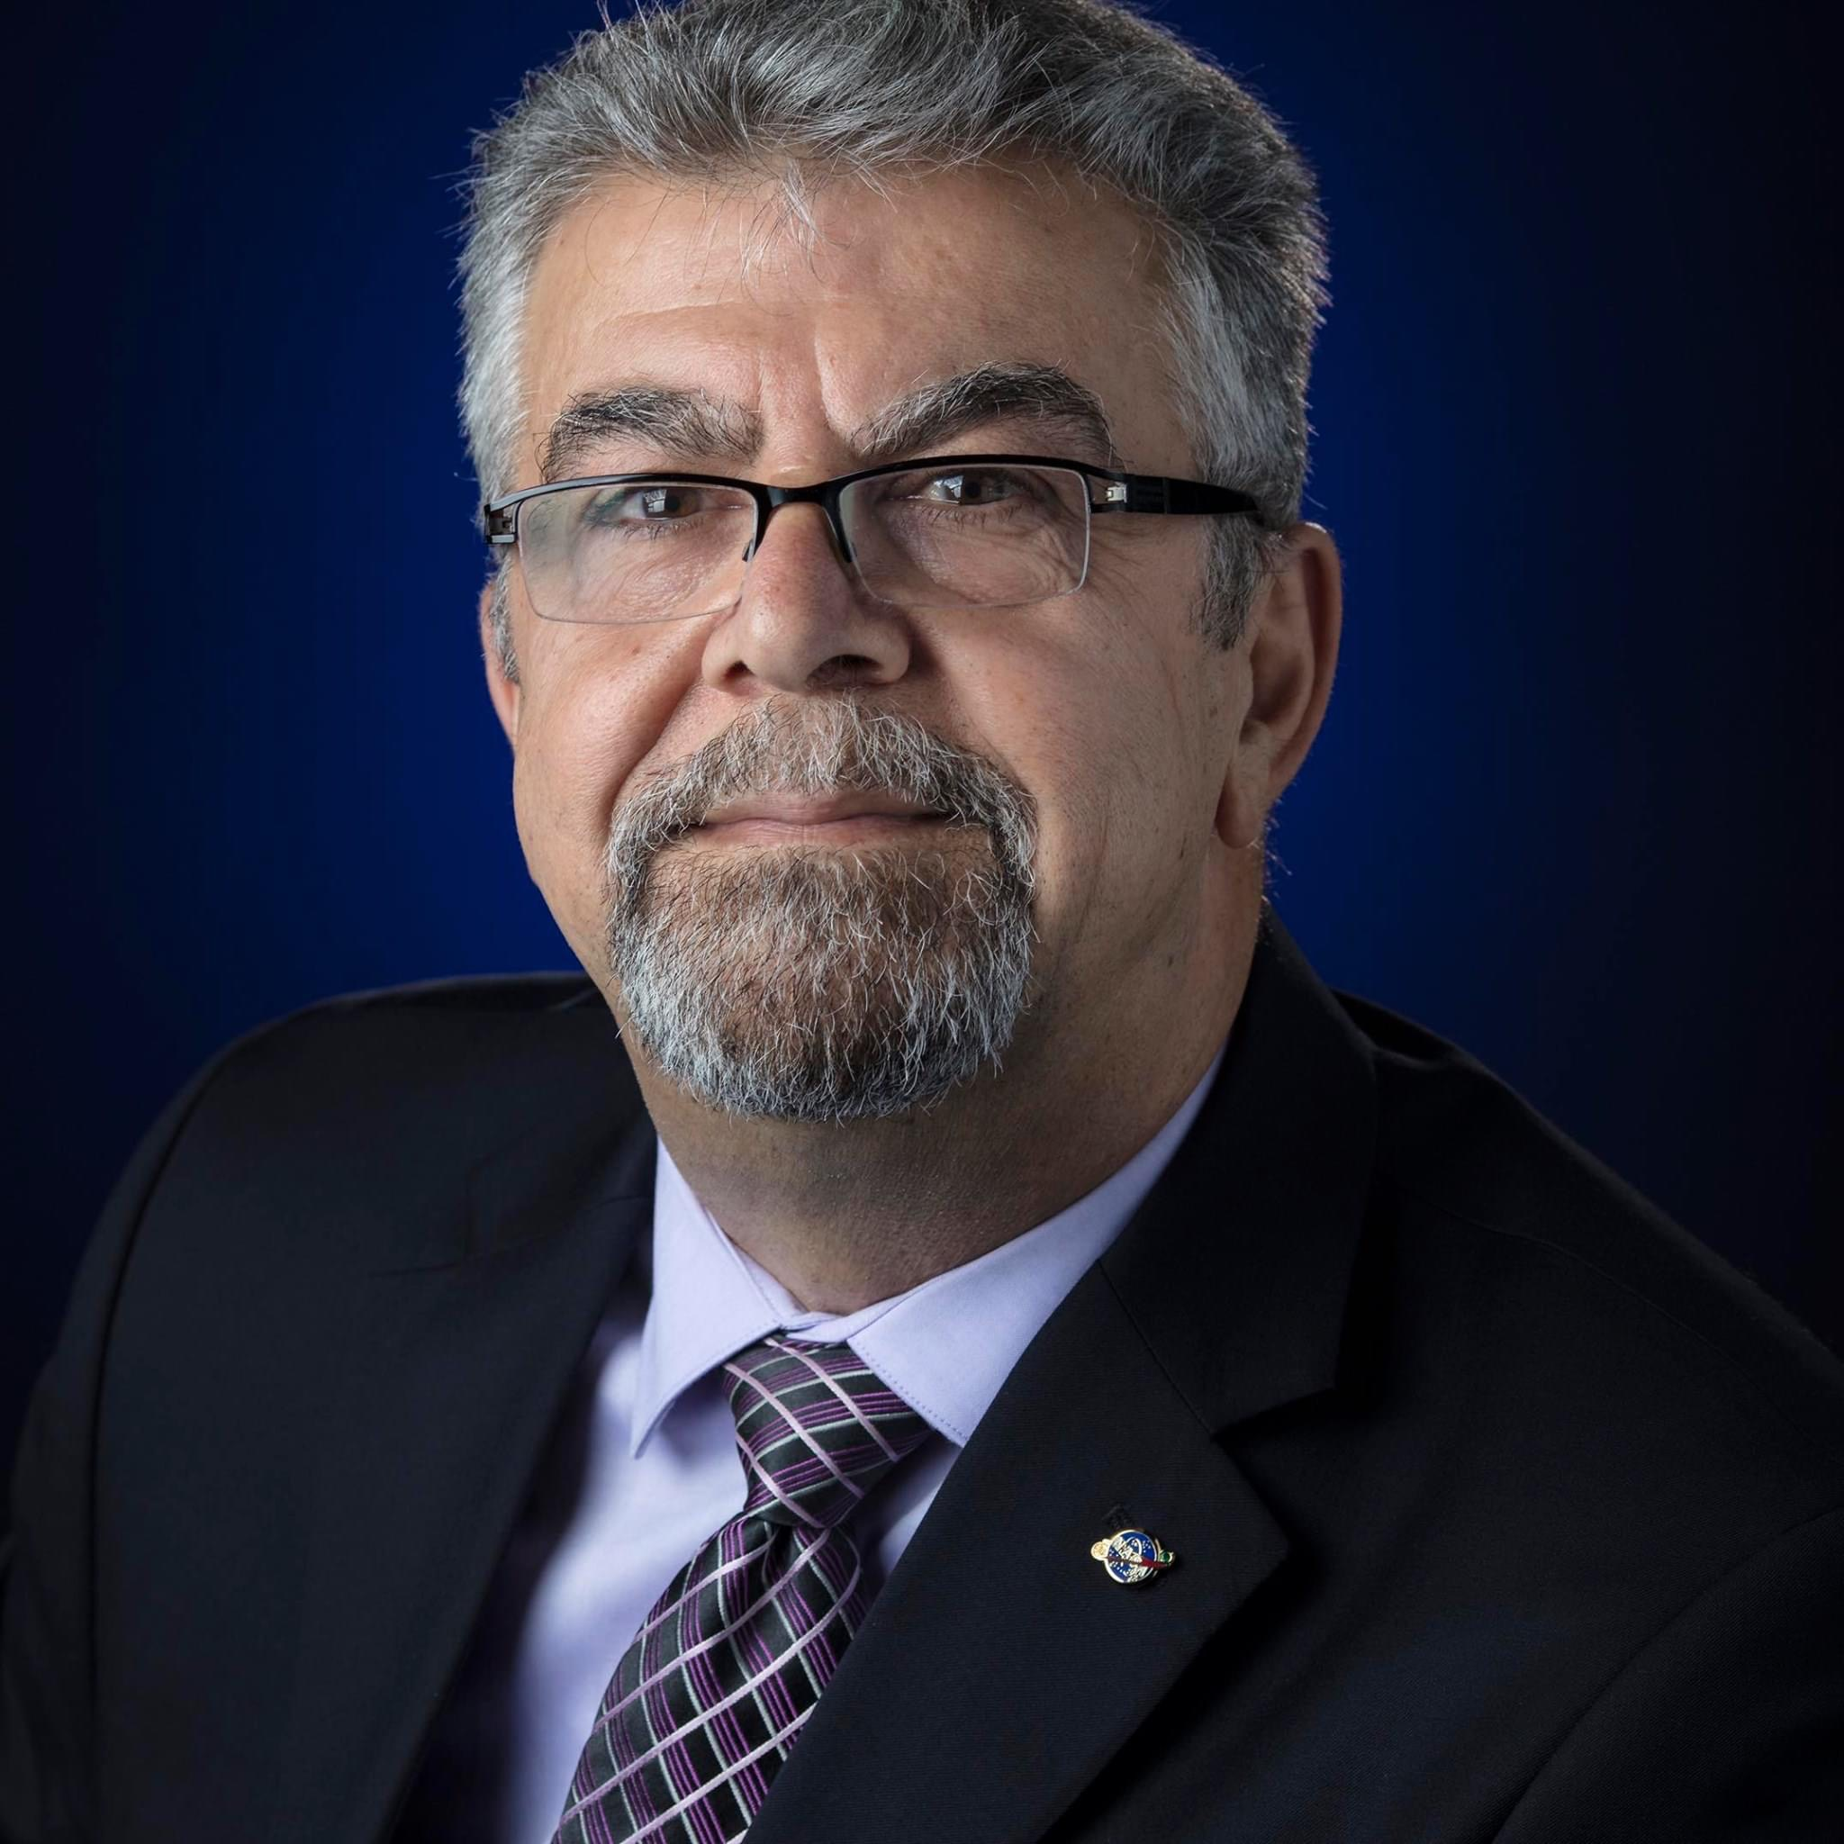
Badri Younes is the Deputy Associate Administrator for Space Communications and Navigation (SCaN). He is responsible for all activities associated with NASA's space communications and navigation policy, infrastructure and services, as well as spectrum management and data standards. Younes is also responsible for the development of enabling transformational technologies critical to meeting the Agency's vision for an integrated SCaN architecture aligned with NASA's future space exploration needs.
Prior to returning to NASA in 2007, Younes was the Department of Defense (DoD) Director for Spectrum Management with responsibility for spectrum policy and strategic planning and implementation. Under his leadership, the department successfully negotiated major win-win agreements with the Federal Communications Commission, National Telecommunications Information Administration, and the U.S. private sector. He successfully led the DoD spectrum management organisation to become more proactive in addressing radiofrequency (RF) and spectrum issues. He has been instrumental in transforming the management and use of the electromagnetic spectrum.
Badri Younes
Deputy Associate Administrator for Space Communications & Navigation
The National Aeronautics and Space Administration (NASA)

Slide 4
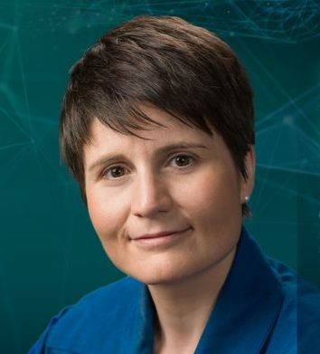
Italian ESA astronaut Samantha Cristoforetti was first launched to the International Space Station in 2014 for her 200-day Italian Space Agency ASI mission, Futura. In 2022 she returned to Earth’s orbital outpost ready for a new ESA mission: Minerva.
Samantha holds a Master’s degree in mechanical engineering with specialisations in aerospace propulsion and lightweight structures. She also earned her fighter pilot wings in 2006 as part of the Italian Air Force before being assigned to fly the AM-X ground attack fighter at the 51st Bomber Wing based in Istrana, Italy.
In 2009, Samantha was selected as an ESA astronaut and in 2012 she was assigned her first space mission to the International Space Station as a flight engineer on Russian spacecraft Soyuz TMA-15M for Expedition 42/43.
In 2022 Cristoforetti was launched to the Station once again – this time alongside NASA astronauts Kjell Lindgren, Bob Hines and Jessica Watkins in a SpaceX Crew Dragon as a member of Crew-4. She served as a member of Expedition 67.
Samantha Cristoforetti
Astronaut
European Space Agency (ESA)

Slide 5
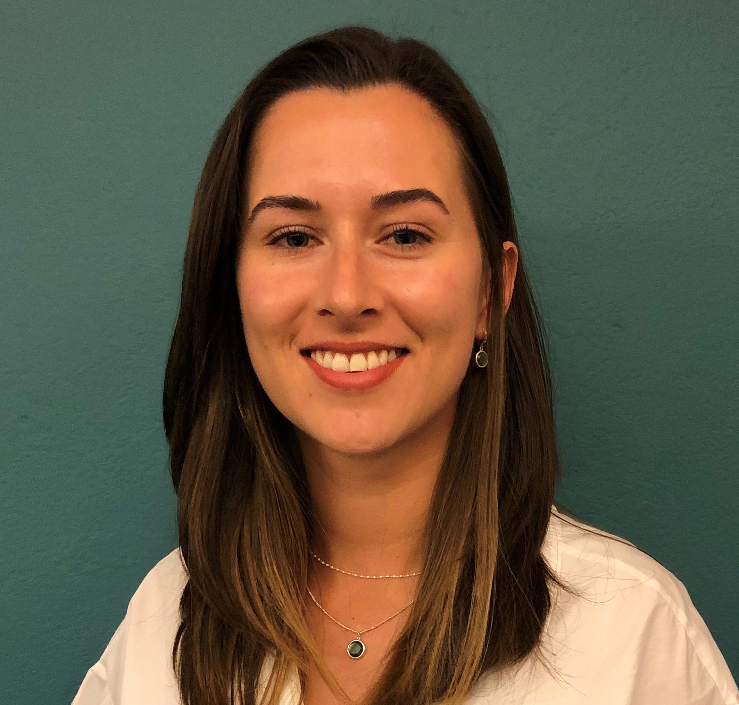
Charlotte Nassey oversees Government affairs for ispace Europe, coordinating public-private partnerships and supporting policy making on commercialisation for space exploration. ispace is a global lunar exploration company offering transportation and exploration services.
Prior to joining ispace, Nassey worked in the procurement department at ESA as an assistant contracts officer for the ARTES programme. She graduated from a Master's in space and telecommunications law from the University of Paris-Saclay and holds a Master's in space studies from the International Space University.
Charlotte Nassey
Business Development & Government Affairs Officer
ispace Europe SA

Slide 6
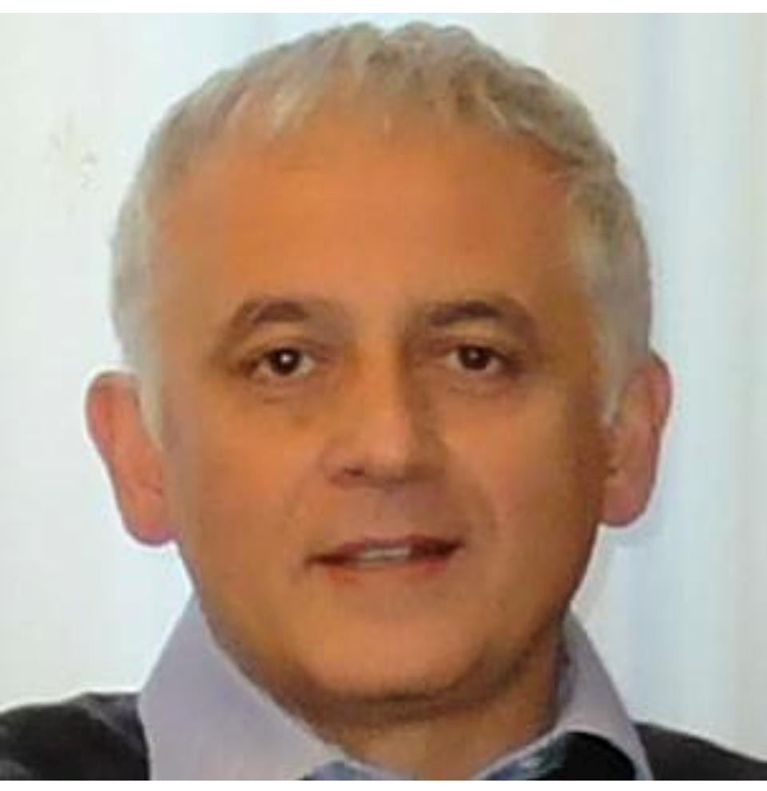
Roberto Formaro has a degree in naval and mechanical engineering from the University of Naples and has thirty years of experience in the creation of major works and projects in the aerospace, oil and gas and construction sectors.
For 20 years at the Italian Space Agency, he has dealt with technologies and the realisation of complex space projects and has held numerous organisational positions.
Currently he is Director of the Programs and since 2015 has been the Italian Delegate at the Industrial Policy Committee of ESA.
Roberto Formaro
Programs director
ASI

Slide 7
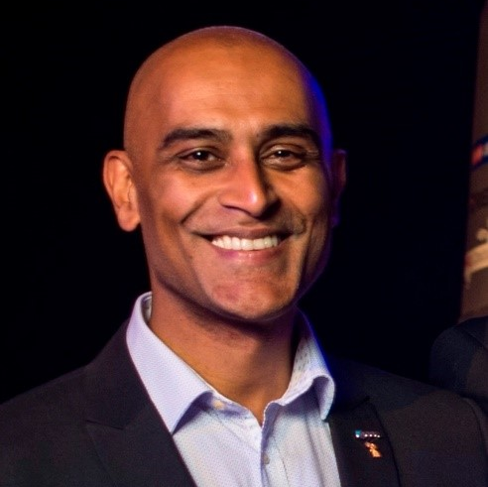
Anu Ojha OBE is a member of the Executive Committee of the UK Space Agency (UKSA) and director for the Championing Space Directorate. Included in his portfolio is leadership of the agency’s International and ESA Policy teams as well as UKSA’s public and parliamentary affairs, communications and education, skills development and inspiration programmes.
Prior to joining the Agency in May 2023, Ojha was the founder of the UK National Space Academy programme and a director of the National Space Centre. Appointed honorary professor in the School of Physics and Astronomy at the University of Leicester in 2016, he is a co-investigator in the University’s programme for nuclear power applications for exploration and has also been involved in data analysis from ESA’s Rosetta, Mars Express and SOHO missions. He continues to teach on the University’s MSc course in space exploration systems specialising in human survival in extreme environments.
From 2018 to 2023, Ojha was a member of ESA’s Human Spaceflight and Exploration Science Advisory Committee (HESAC) based at ESTEC.
Anu Ojha
Director of Championing Space UKSA

Slide 8
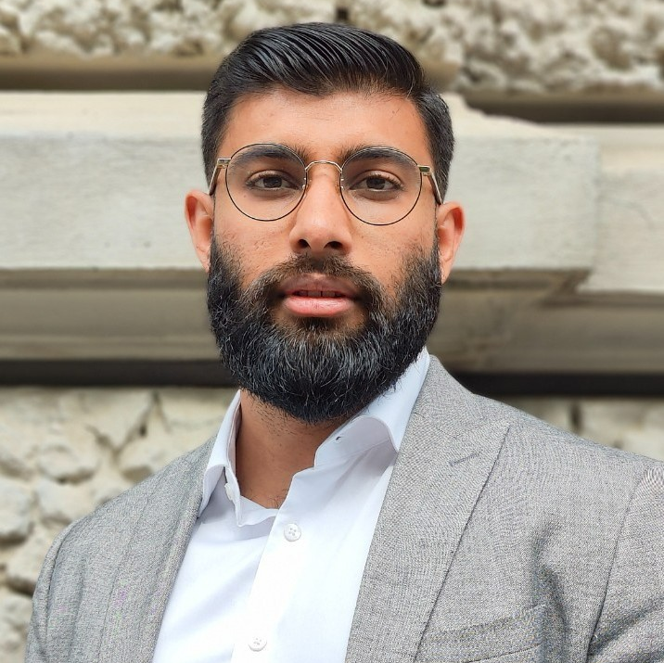
Syed Hussain Bokhari began his consulting work with NSR (an Analysys Mason company) in 2020. He is an active member of the Space Forward Lab and Space Generation Advisory Council – Small Satellites & Space Exploration Project Groups and helps to solve challenges and create solutions for next generation satellites and space exploration.
Bokhari previously worked with Satellite Canada Innovation Network as a business development manager. He conducted market assessments, strategic analyses and commercial due diligence. He also worked for Ryerson University as a project development officer in the student engagement team, and as a systems engineer at Ryerson University Space Systems.
Bokhari has a Bachelor’s and Master’s in aerospace engineering from Ryerson University, with a speciality in systems engineering. He also has a certificate in data analytics, big data and predictive analytics. Recently, Bokhari completed the Interactive Space Program at the International Space University, where he worked on a report on how to prepare, prevent, monitor and mitigate pandemics using space technologies.
Syed Hussain Bokhari
Senior Analyst
Northern Sky Research (NSR)

