Slide 1
Session 5
ENABLERS
DIGITAL TRANSFORMATION IN SATCOM

Slide 2
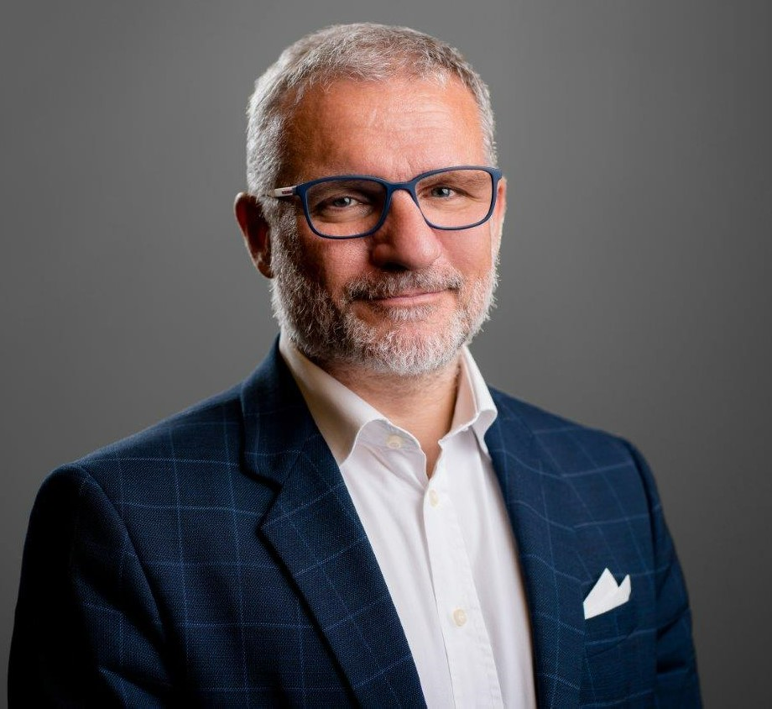
Guido Baraglia’s experience in aerospace spans over 35 years, from ground station operation and satellite payload management, to business development and sales. He recently led the newly formed Amazon Web Services Aerospace & Satellite business unit in EMEA.
Baraglia has developed untapped vertical markets and proposed the most appropriate solution to complex or innovative requirements. An early supporter of the ground virtualisation evolution, he envisions a future with a cloud-based seamless infrastructure, where space is one of the key elements of the global communication and content distribution network.
Baraglia's primary task is to support innovation in the regional space market by focusing on joining space and satellite requirements with advanced cloud capabilities, enabling transformation of the space ecosystem. This touches every aspect of the space business, including data analytics and intelligence, spacecraft and rockets and human missions.
Guido Baraglia
Head of Space & Satellite EMEA
AWS Aerospace & Satellite

Slide 3
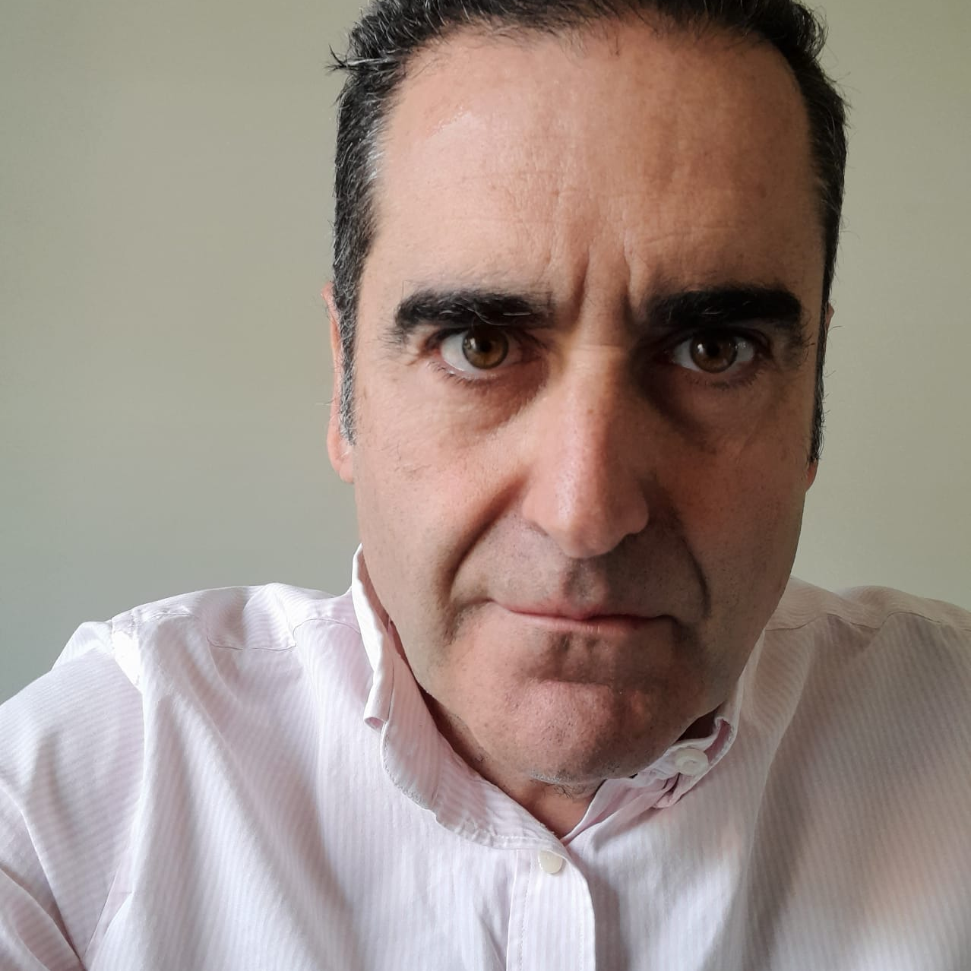
Afonso Nunes has made significant contributions to the space business through his exceptional technical skills, deep market understanding, and remarkable ability to inspire and mobilise teams. His journey as a subject matter expert began in the mid-90s with his academic achievements in microwave electronics.
Nunes has engaged in research in avionics and working on mobile communications and Telecommunications Management Networks. Moving into the space industry, he worked on satellite datalinks for aviation, satellite transport split architectures, satellite navigation systems, remote sensing, downstream applications and satellite mission control. Nunes later worked on a secure satellite datalink system for air traffic management (ATM), milsatcom projects, 5G, artificial intelligence and network protocols for mega-constellations.
Beyond his professional accomplishments, Nunes is a person with many passions: classical music, classic cars, vintage watches (just don't ask him the time), motorbikes, cycling and his family, particularly his young daughters.
Afonso Nunes
Technology Business Development
CGI

Slide 4
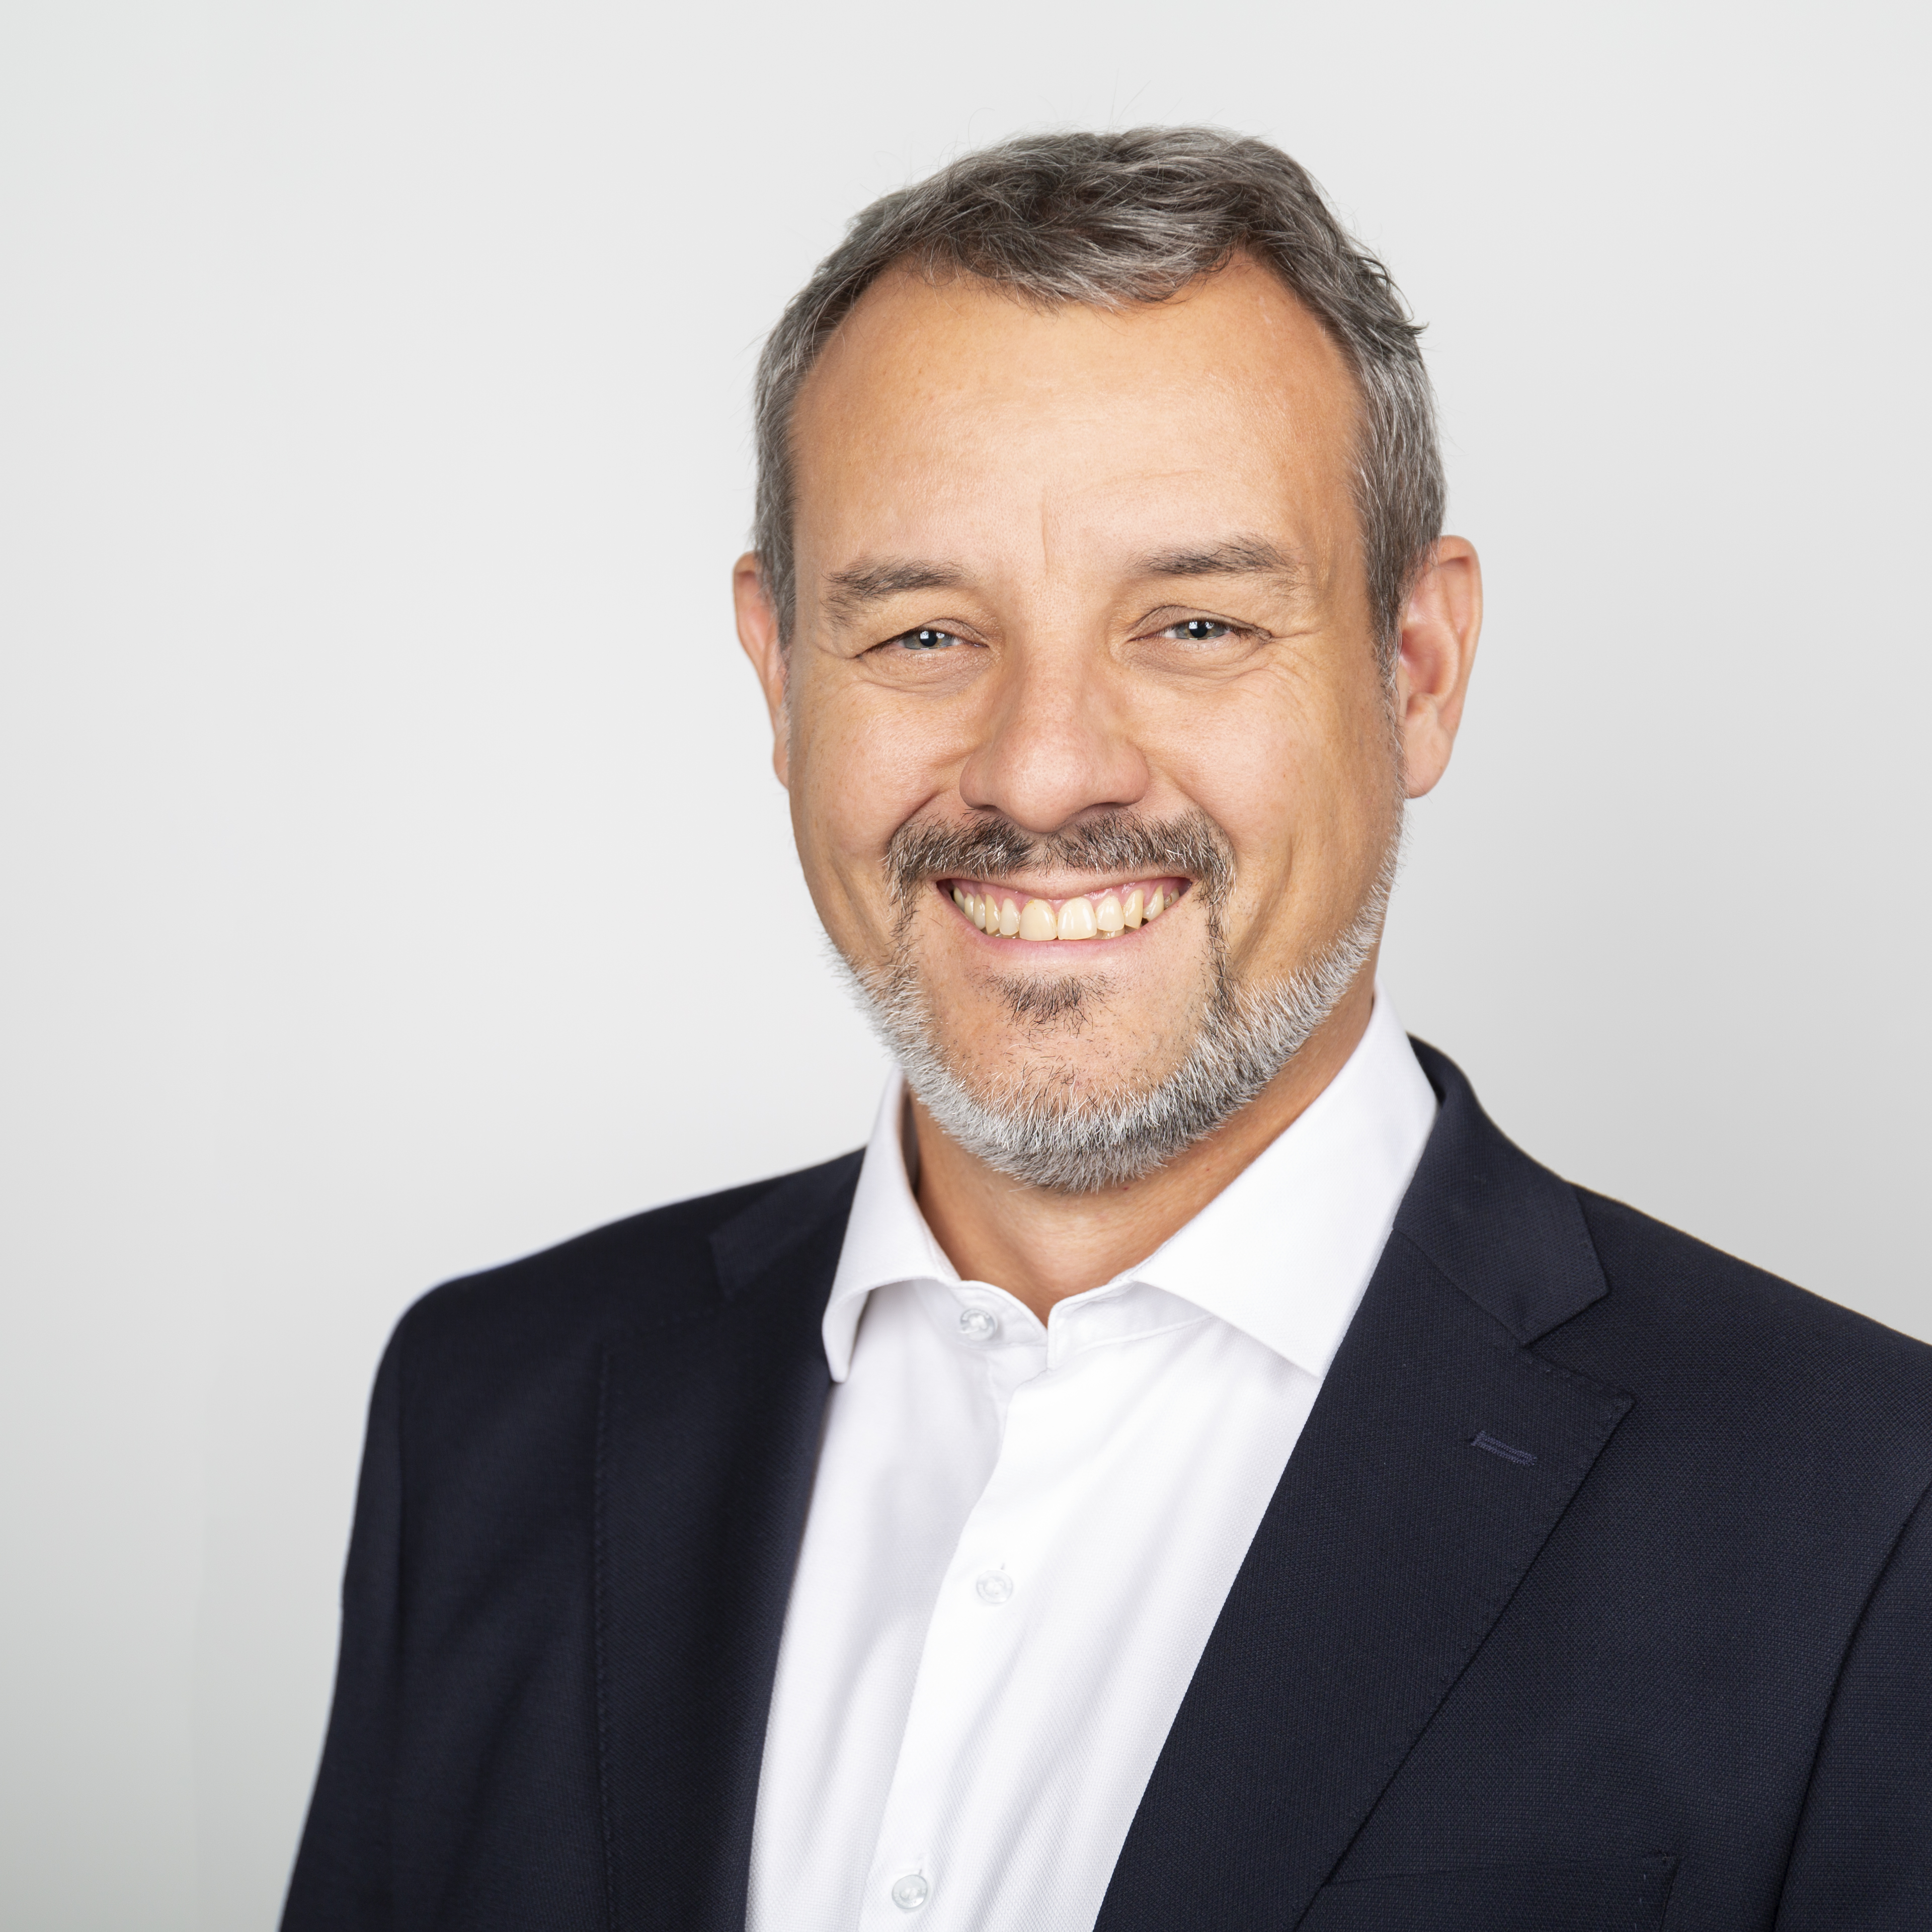
Enrique Fraga is a mathematics graduate specialising in programming, who began working as a software architect for telecommunications projects.
21 years ago, he joined GMV, working in the satellite control-centre area, where he has had a variety of roles: technical engineer to director of GMV’s Satellite and Mission Control Business Unit.
During this period, GMV became the world’s leading supplier of ground-control systems for commercial satellites and one of the significant GS software providers for ESA and EUMETSAT.
He has recently been appointed as general manager of GMV Space Systems EST (Earth Observation, Exploration, Science, Space Safety, Telecom and Transportation).
Enrique Fraga Moreira
Director of Space
GMV

Slide 5
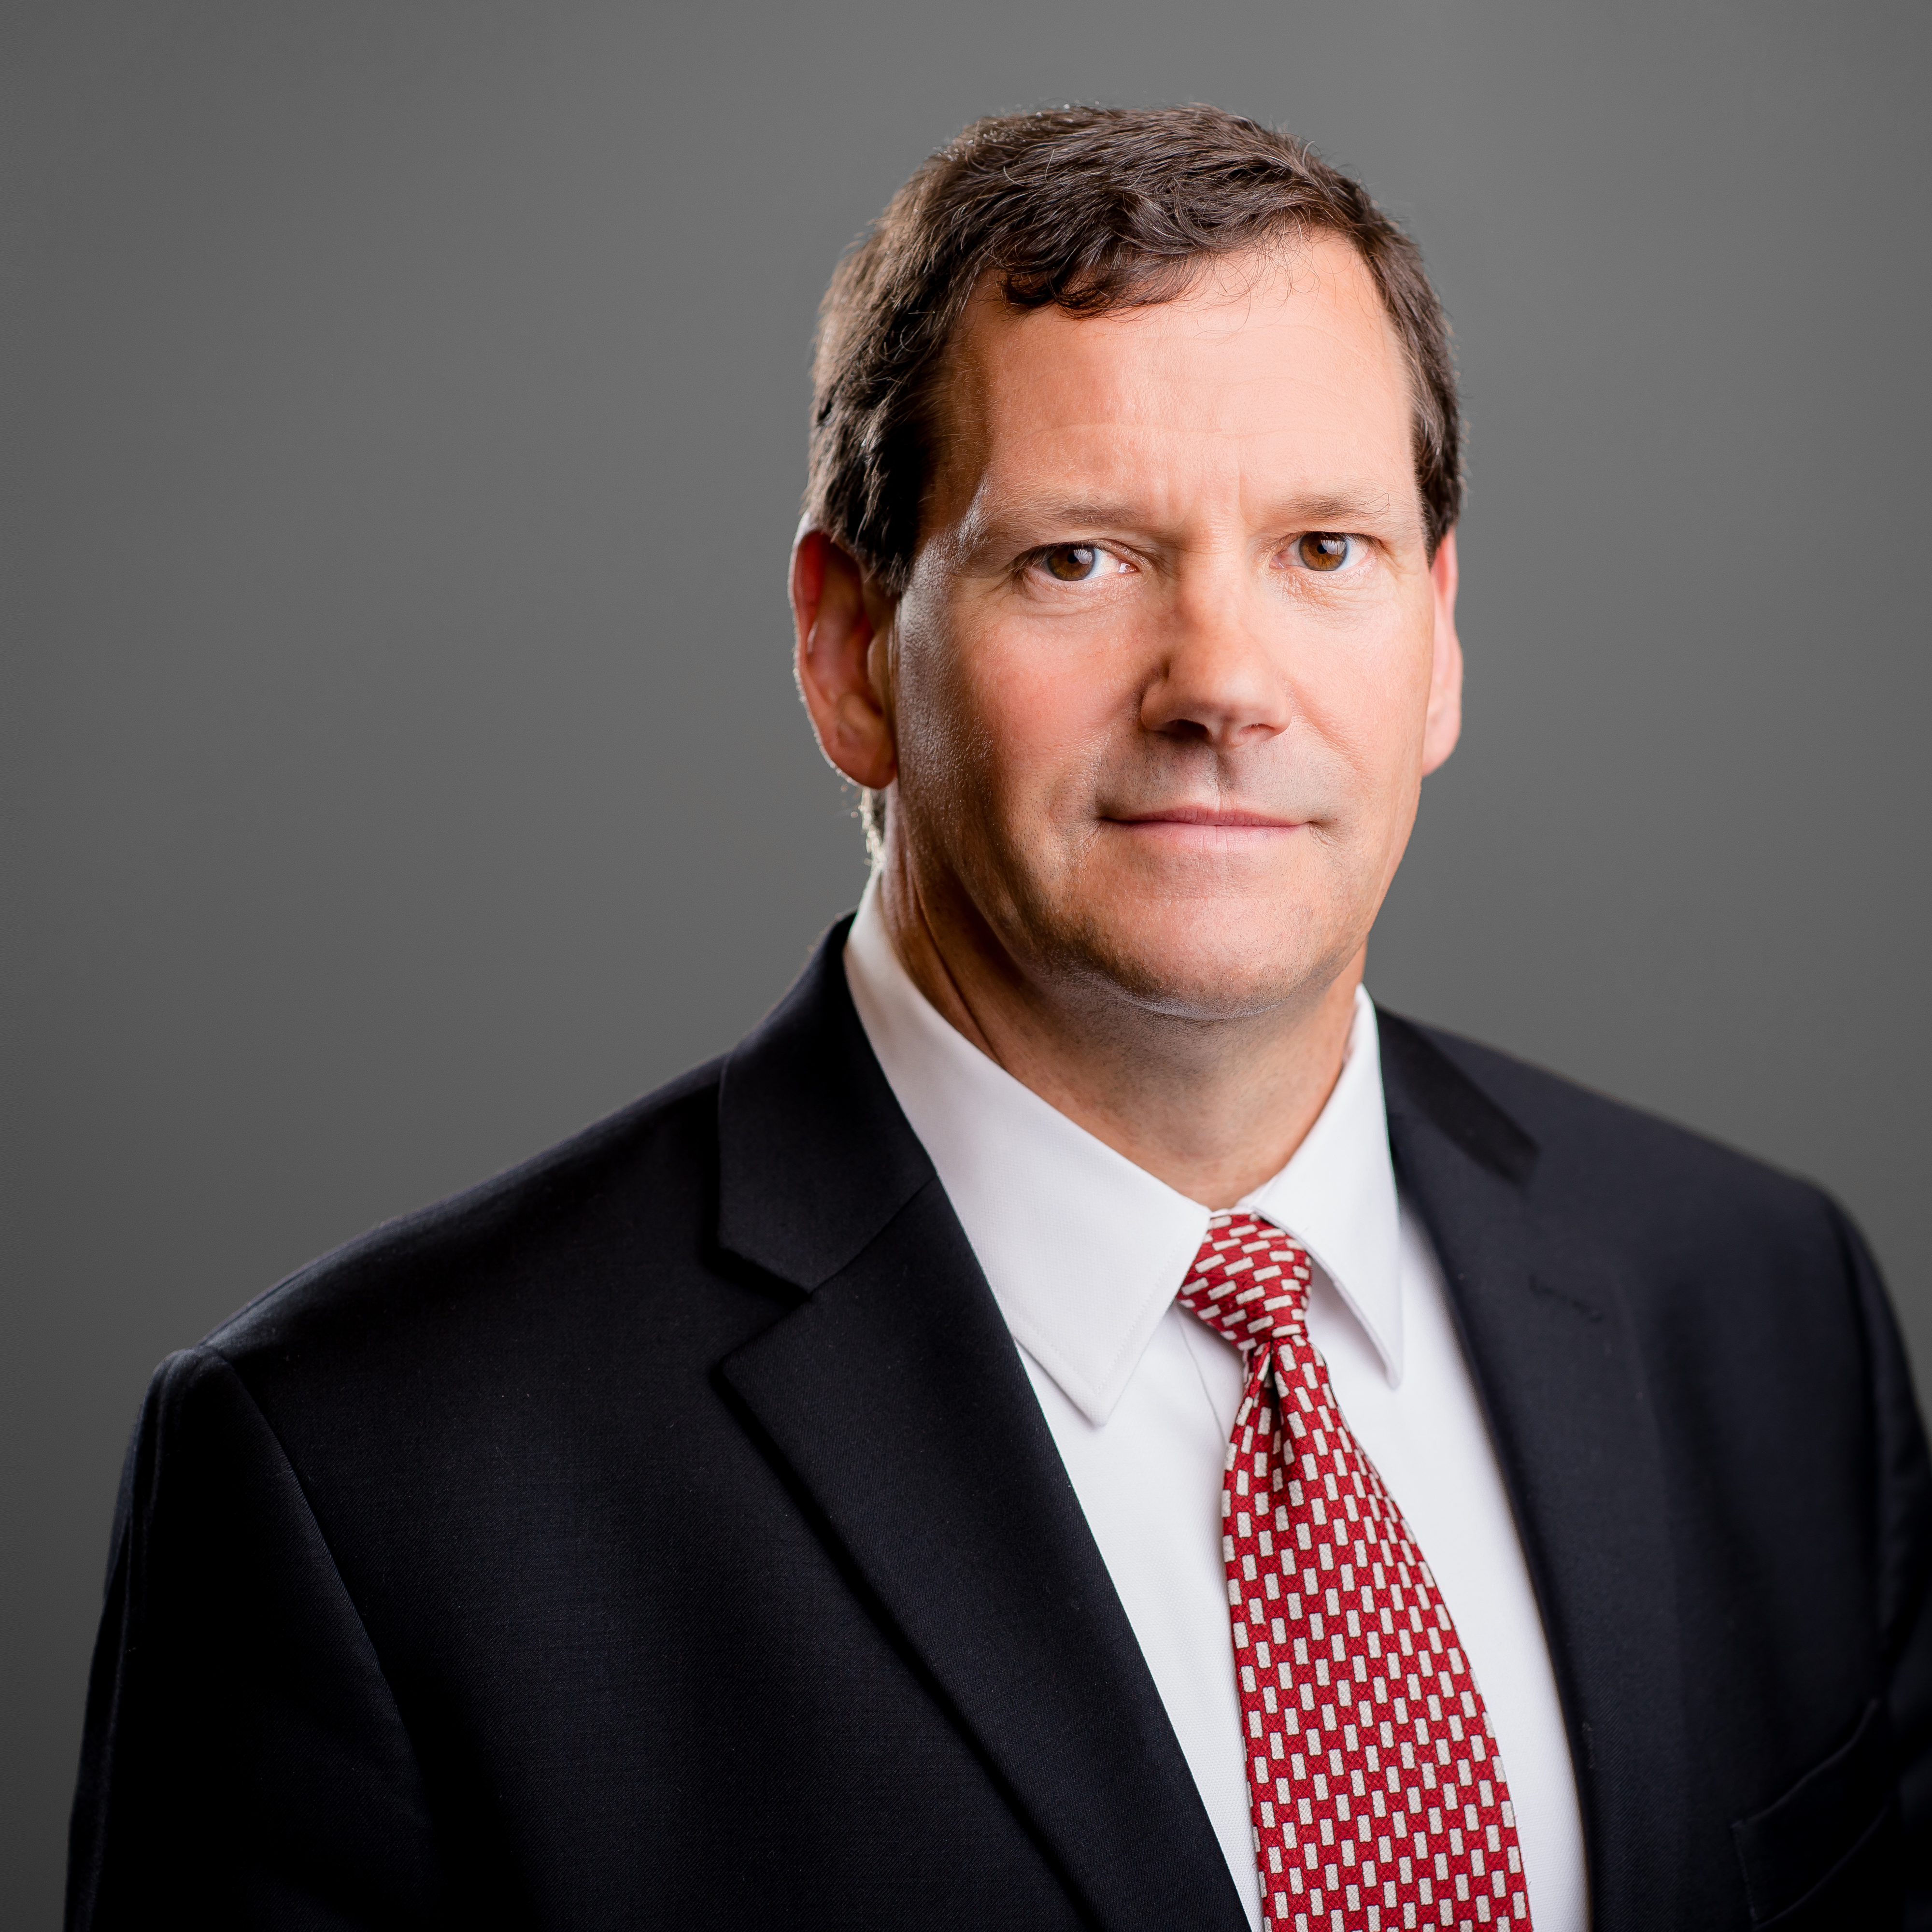
Stuart Daughtridge has extensive experience in the satellite and aerospace industry, spanning over 30 years.
In his current position of vice president of advance technology, he leads Kratos’ satellite ground segment technology initiatives, including the planning for the next generation of ground-segment technology. In this role, Daughtridge is focused on today’s innovative and advanced technologies that will enable the ground station to become more dynamic, scalable, secure and cost-effective for customers.
Prior to his current role at Kratos, he has held several senior management positions within the company. Daughtridge has also held various management and engineering positions with Orion Satellite Corporation, Intelsat, and Spacecom. He holds a Bachelor of Science from Lafayette College.
Stuart Daughtridge
Vice President of Advance Technology
Kratos Defense & Security Solutions

