Slide 1
Session 7
VALUES
SPACE FOR A GREEN TRANSITION
AND RESILIENCE TO CLIMATE IMPACT

Slide 2
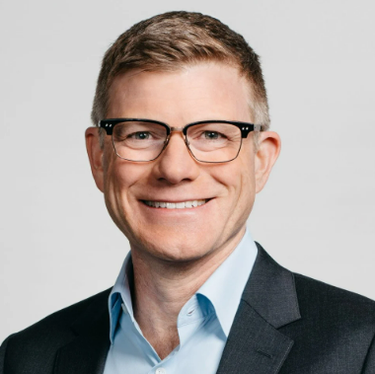
Barry French was appointed as Inmarsat’s Chief Marketing & Communications Officer in April 2021. An award-winning, multi-industry leader in communications, marketing and corporate affairs, he joins Inmarsat from Nokia, where he was chief marketing officer from 2014 to 2020. During his time at the company, French was responsible for fundamentally repositioning Nokia Siemens Networks as a mobile networks specialist, rebuilding the Nokia brand, amplifying its value by more than four times and strengthening financial communications.
French pioneered an award-winning sustainability programme and was a key member of the executive leadership team that drove the Alcatel-Lucent acquisition.
French started his career in the world of political consulting in the United States and has worked at companies including the Sawyer/Miller Group, Dell, Raytheon, United Airlines and Nokia. A Political Science graduate, he holds a Master's in international affairs from Columbia University’s School of International and Public Affairs in New York.
Barry French
Chief Marketing & Communications Officer
Inmarsat

Slide 3
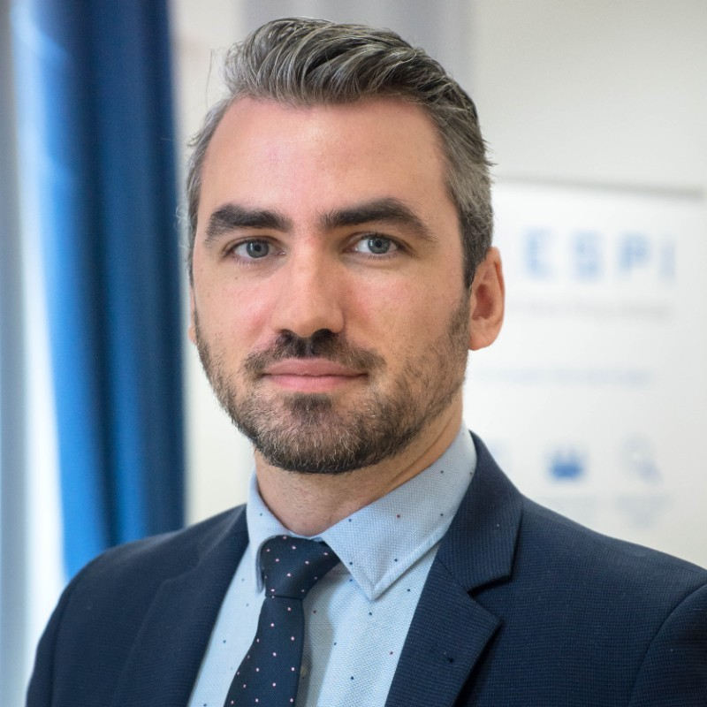
Sebastien Moranta coordinates the development of the Accelerators at ESA, a new concept of cooperation and action to boost the use of space to address urgent global challenges.
Prior to joining ESA, he was the manager of the European Space Policy Institute, an independent think-tank specialised in space-related affairs. Moranta was also a senior associate at PricewaterhouseCoopers Advisory where he managed space-related studies for the European Commission, ESA, GSA and other space sector stakeholders.
Moranta was also a former analyst at Eurospace, the association of the European space industry, where he worked on a variety of space-related topics including strategy and policy, programme management, R&D&I, standardisation, security, business and economics across different space domains.
Moranta has an aerospace engineer degree from the Institut Polytechnique des Sciences Avancées (IPSA) in Paris.
Sebastien Moranta
Accelerator Development Coordinator
European Space Agency (ESA)

Slide 4
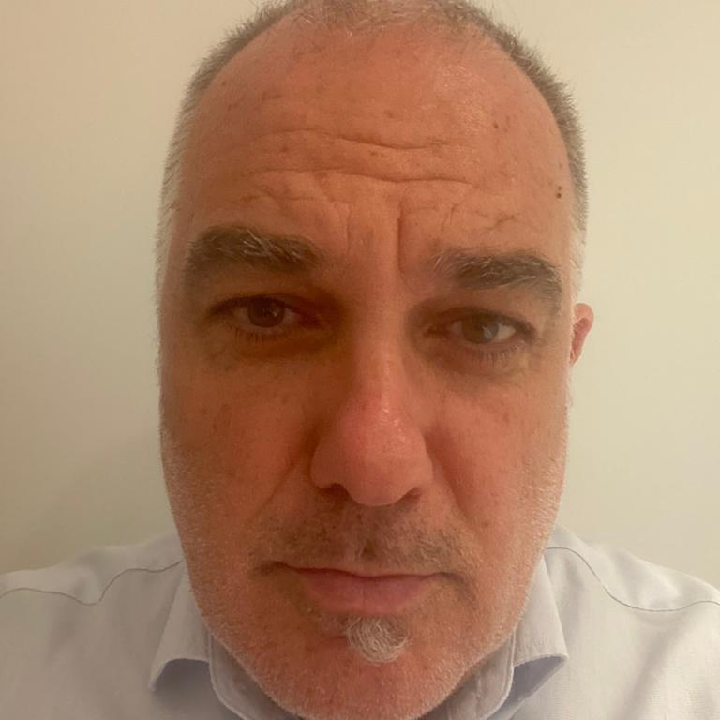
Alessio Leone is CAMO Postholder of ITA Airways, the new Italian Airline that started operations in October 2021. He has the responsibility of ensuring the technical efficiency and airworthiness status of the fleet - which since the beginning of operations, in a short time, grew up with entry into the service of new technology aircraft, Airbus A350, A220, A330neo and A320neo.
After his University degree in aeronautical engineering at University “La Sapienza” of Rome, he moved to Sardinia where he started working in the Technical Office of a small turboprop aircraft operator. He then moved to Airline AirOne, where he worked in the Quality & Safety department, becoming Quality & Safety Director until his Alitalia experience in the Engineering & Maintenance department as Vice President Technical Services until July 2021, where he participated in the startup of ITA Airways.
Alessio Leone
Postholder CAMO –
Maintenance Executive
ITA Airways

Slide 5
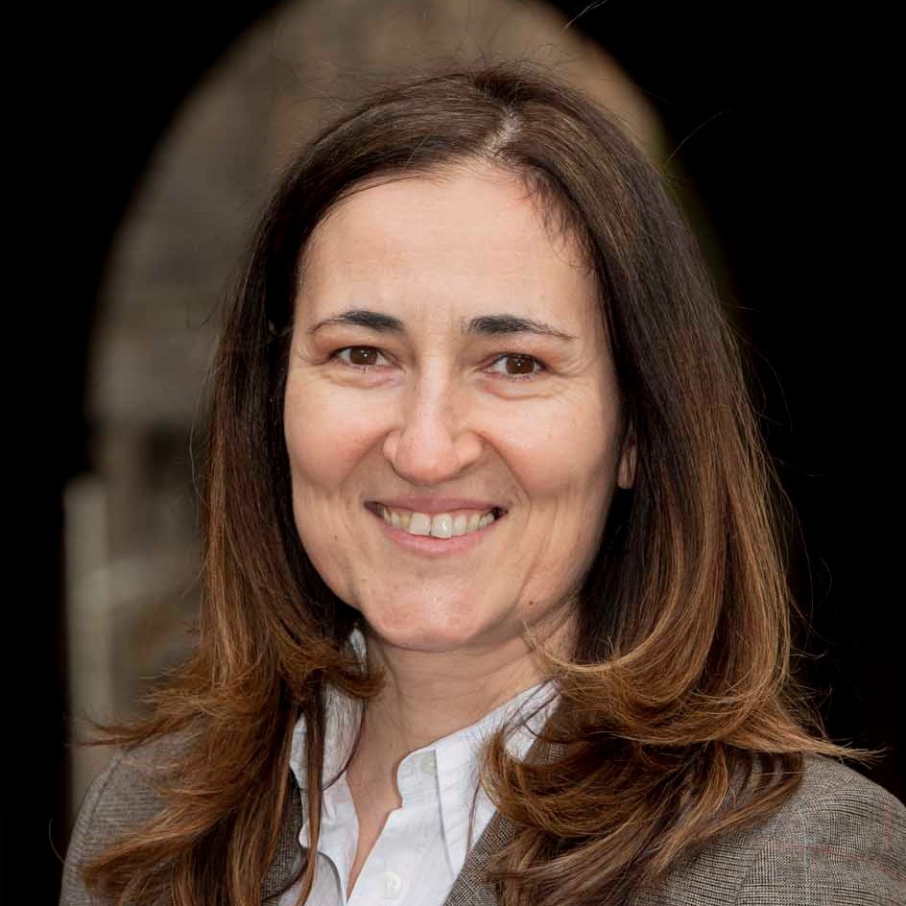
Daniela Petrovic is the co-founder of Darwin Innovation Group, a highly successful R&D company focussed on implementation of ubiquitous communication solutions to connected autonomous vehicles (CAVs).
Petrovic believes in an important triangle, government-industry-academia, in shaping the future of innovation. Her academic research is focused on creation of frameworks for making successful innovation ecosystems and highlighting their importance for enhancing the cycle of industry-academia- industry knowledge exchange.
Petrovic’s background is in engineering and business management and her career spans over 20 years of working in executive management roles across Europe and Asia to set and execute planned and emergent strategies in the spaces of innovation and new technologies. Equally enthusiastic to create strategy for new products in the marketplace and creating new markets for the products, Daniela’s vision is for Darwin to be an enabler of CAVs becoming mainstream eco-friendly transport options.
Daniela Petrovic
Co-founder
Darwin Innovation Group

Slide 6
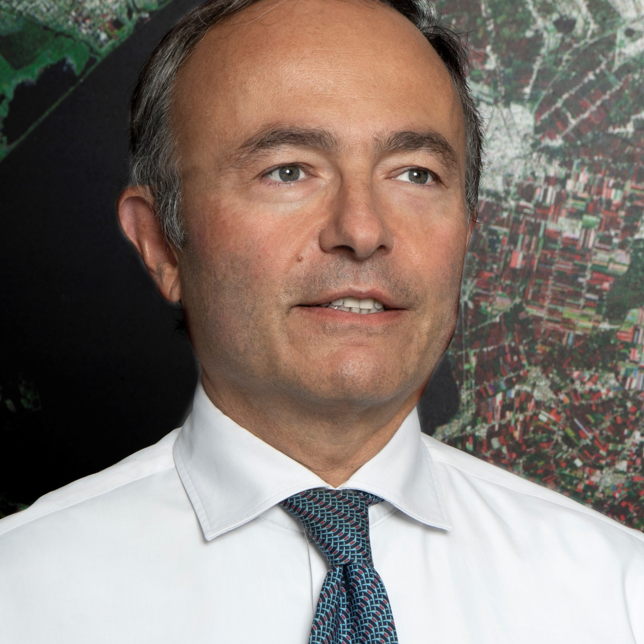
Paolo Minciacchi graduated in Electronic Engineering at La Sapienza University of Rome. He has served as the chief executive officer of e-GEOS since 2020.
In 1990 Minciacchi joined Telespazio, holding many positions in the management of several satellite missions, including ITALSAT, SAX, SICRAL and EUTELSAT.
In 2007 he was appointed Executive for the Telespazio board and head of Programs & Application Solutions and Systems. Later, in 2009, Minciacchi became head of Operational Planning, Industrial Management and Value Added Production at e-GEOS, an ASI (20%) / Telespazio (80%) company.
In 2011, he joined Spaceopal (a joint venture by DLR Gesellschaft für Raumfahrtanwendungen (GfR) mbH and Telespazio) as technical director and member of the Executive Committee and in 2018 he took the role of Spaceopal's chief executing officer.
Paolo Minciacchi
Chief Executive Officer
e-GEOS

